Slide 1
Year 1- Knowledge Organisers

Slide 2
Geography

Slide 3

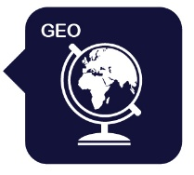
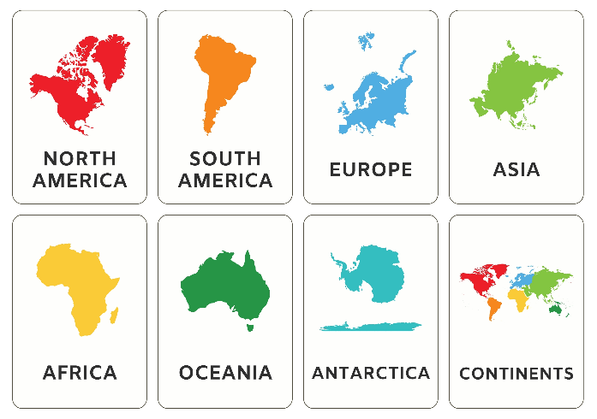
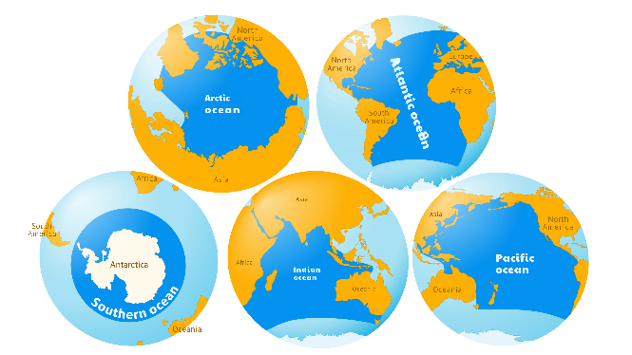
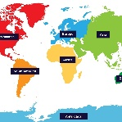
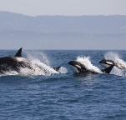
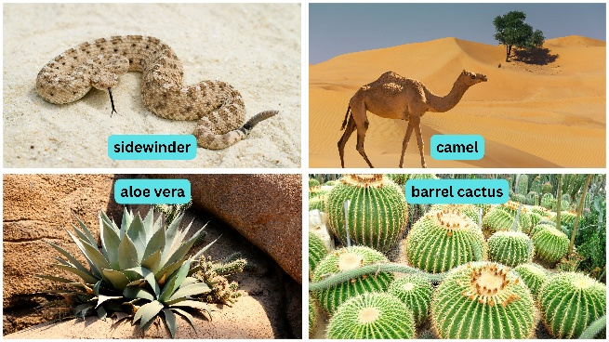
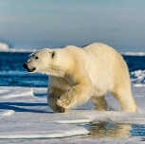
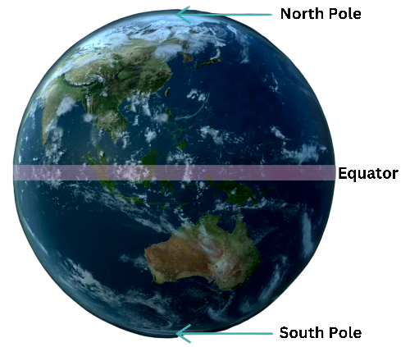
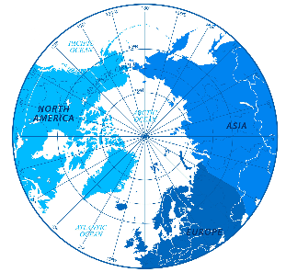
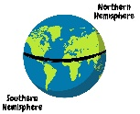
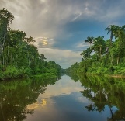
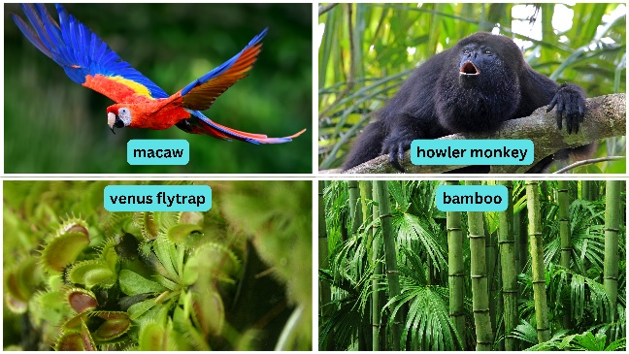
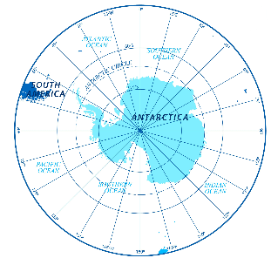
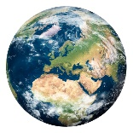
Knowledge Organiser: Year 1 - The World
Careers connected to this unit: meteorologist, weather forecaster, climatologist
Lesson Sequence
Continents of the world
Oceans of the world
1. What are continents?
2. What are oceans?
Desert animals and plants
3. What is it like in the North and South Poles?
Features of the globe
sidewinder
camel
aloe vera
barrel cactus
4. What is the equator?
Rainforest animals and plants
5. How are rainforests and deserts different?
The equator is the line geographers draw which splits the northern and southern hemispheres. It is very hot and humid here.
macaw
howler monkey
6. Assessment: What do we know about the world?
Venus flytrap
bamboo
Developing Experts Copyright 2025 All Rights Reserved

Slide 4

Year 1: The World
Knowledge Organiser: The World
Session 2
Rocket Words
world | the planet we live on, called the Earth
continent | a very large area of land made up of different countries
country | a big area of land with its own rules and leaders
North Pole | a very cold place in the Arctic
South Pole | a very cold place in Antarctica
Equator | an area that goes around the middle of the Earth where it is warm
climate | the usual weather a place has over a long time
ocean | a large deep body of salt water
Developing Experts Copyright 2025 All Rights Reserved

Slide 5
History

Slide 6



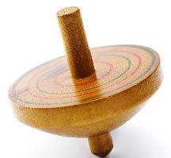
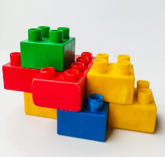
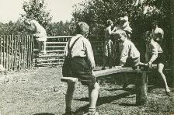
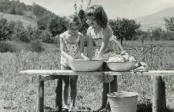


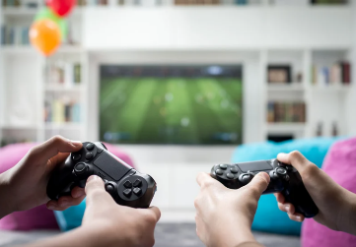

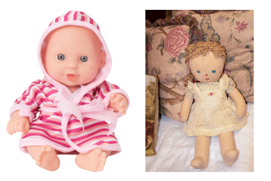


Year 1 – The History of Toys
Knowledge Organiser
Careers connected to this unit: historian, toy designer, museum curator
Lesson Sequence
Materials that toys are made from
How children played differently
1. What do ‘past’ and ‘present’ mean?
2. Do toys from the past look the same as toys from today?
Past toys were mostly made from wood, metal or fabric.
Present toys are often made from plastic and are colourful.
  Children mostly played outside in the past, creating their own games.
  They often had to help with jobs before they could play.
3. What were old toys made from?
Changes in toys over time
4. How have toys changed over time?
5. Why did children play differently in the past?
Children today spend more time indoors. Toys like video consoles allow us to play games online with friends.
Toys in the past were usually simple and handmade.
Toys today are made in factories. They can light up, make sounds or move with batteries.
6. Assessment: Are toys better today?
Developing Experts Copyright 2026 All Rights Reserved

Slide 7


Year 1 – The History of Toys
Knowledge Organiser
Careers connected to this unit: historian, toy designer, museum curator
Rocket Words
past | anything that has already happened
present | the time that is happening now, today
handmade | carefully made by hand, like a doll or a wooden car, instead of being made in a factory
material | what something is made from
technology | machines or tools that help us do things, like watching, playing or learning
imagination | being able to create pictures, ideas or stories in your mind, even if they aren’t real
change | when something becomes different from before
batteries | a small thing that gives power to toys to make them work
Developing Experts Copyright 2026 All Rights Reserved

Slide 8
Science

Slide 9




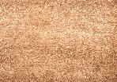



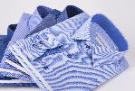
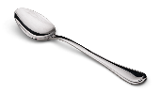
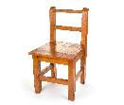




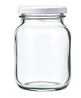
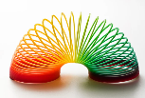







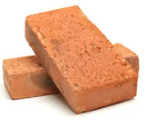
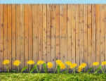
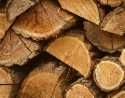
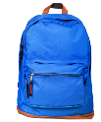

Year 1: Everyday materials
Knowledge Organiser
Careers connected to this unit: engineer, builder, carpenter
Lesson Sequence
Everyday materials
1. Identify and name a variety of everyday materials
fabric
metal
wood
plastic
glass
2. Distinguish between an object and the material it is made from
Objects made from materials
3. Describe the properties of everyday materials
clothes
spoon
chair
bottles
mirror
Properties
Natural
Man-made
4. Identify objects that are natural and those that are manmade
transparent
bendy
absorbent
5. Predict and identify if an object will float or sink
6. Explore which materials are best for different objects
soft
rough
opaque
Developing Experts Copyright 2025 All Rights Reserved

Slide 10

Year 1: Everyday materials
Knowledge Organiser
Careers connected to this unit: engineer, builder, carpenter
Rocket Words
material | anything that is used to make something else
property | words that tell use what a material is like
absorbent | something that soaks up water
transparent | you can see through it
natural | made by nature and not by humans
man-made | made by human beings
waterproof | to not let water pass through
float | to stay on the surface of the water
sink | to fall downwards when placed in water
Developing Experts Copyright 2025 All Rights Reserved

