Slide 1
Year 1 Knowledge Organisers
Autumn 2025

Slide 2


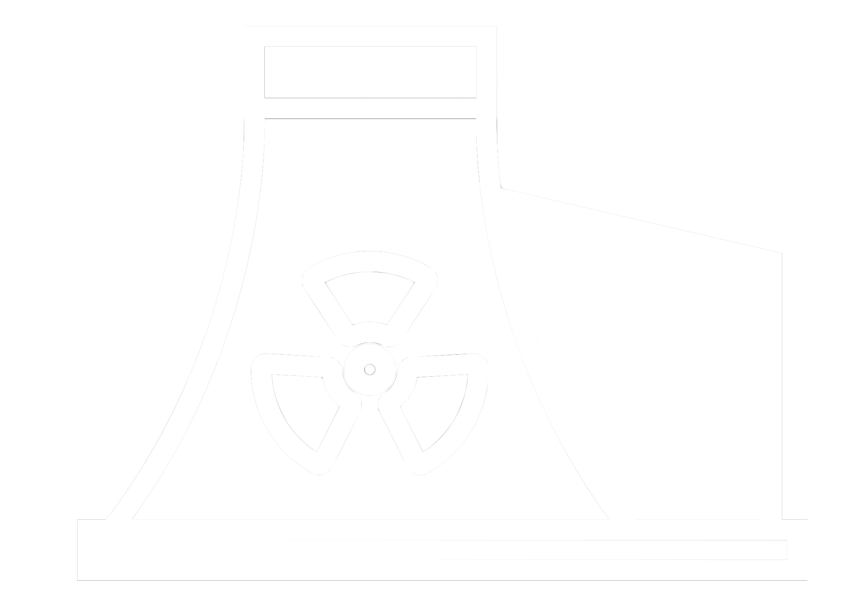






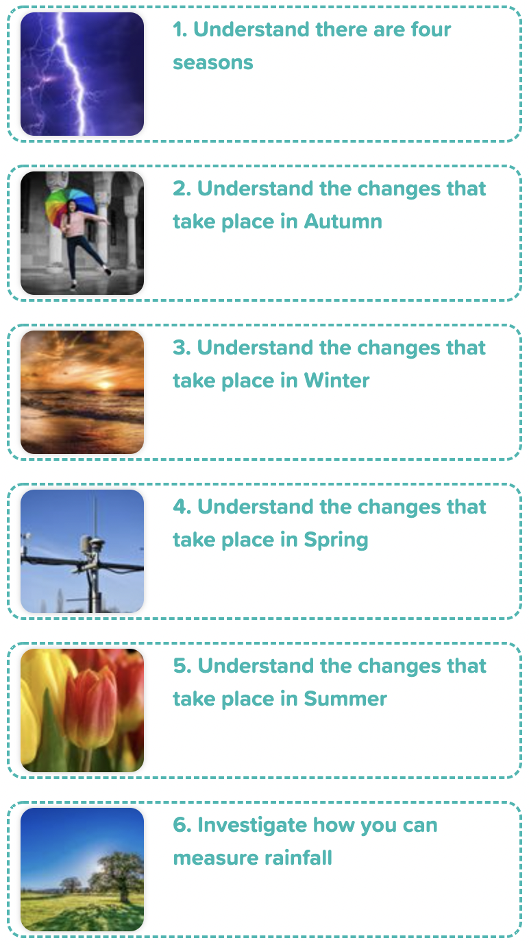
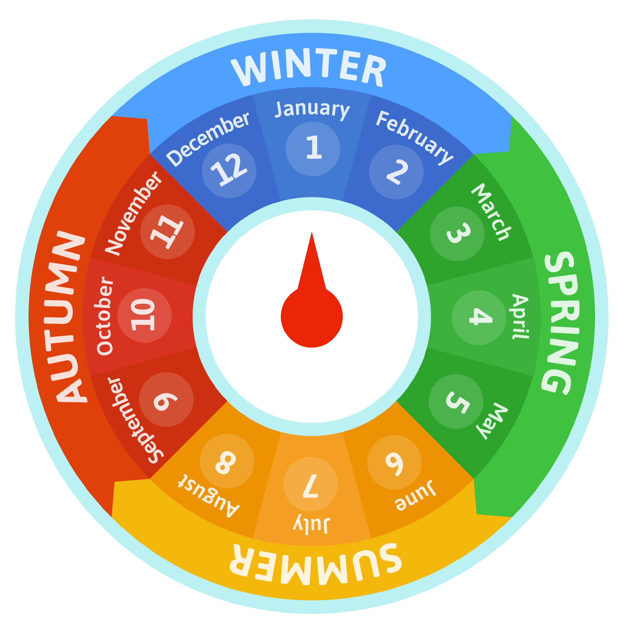
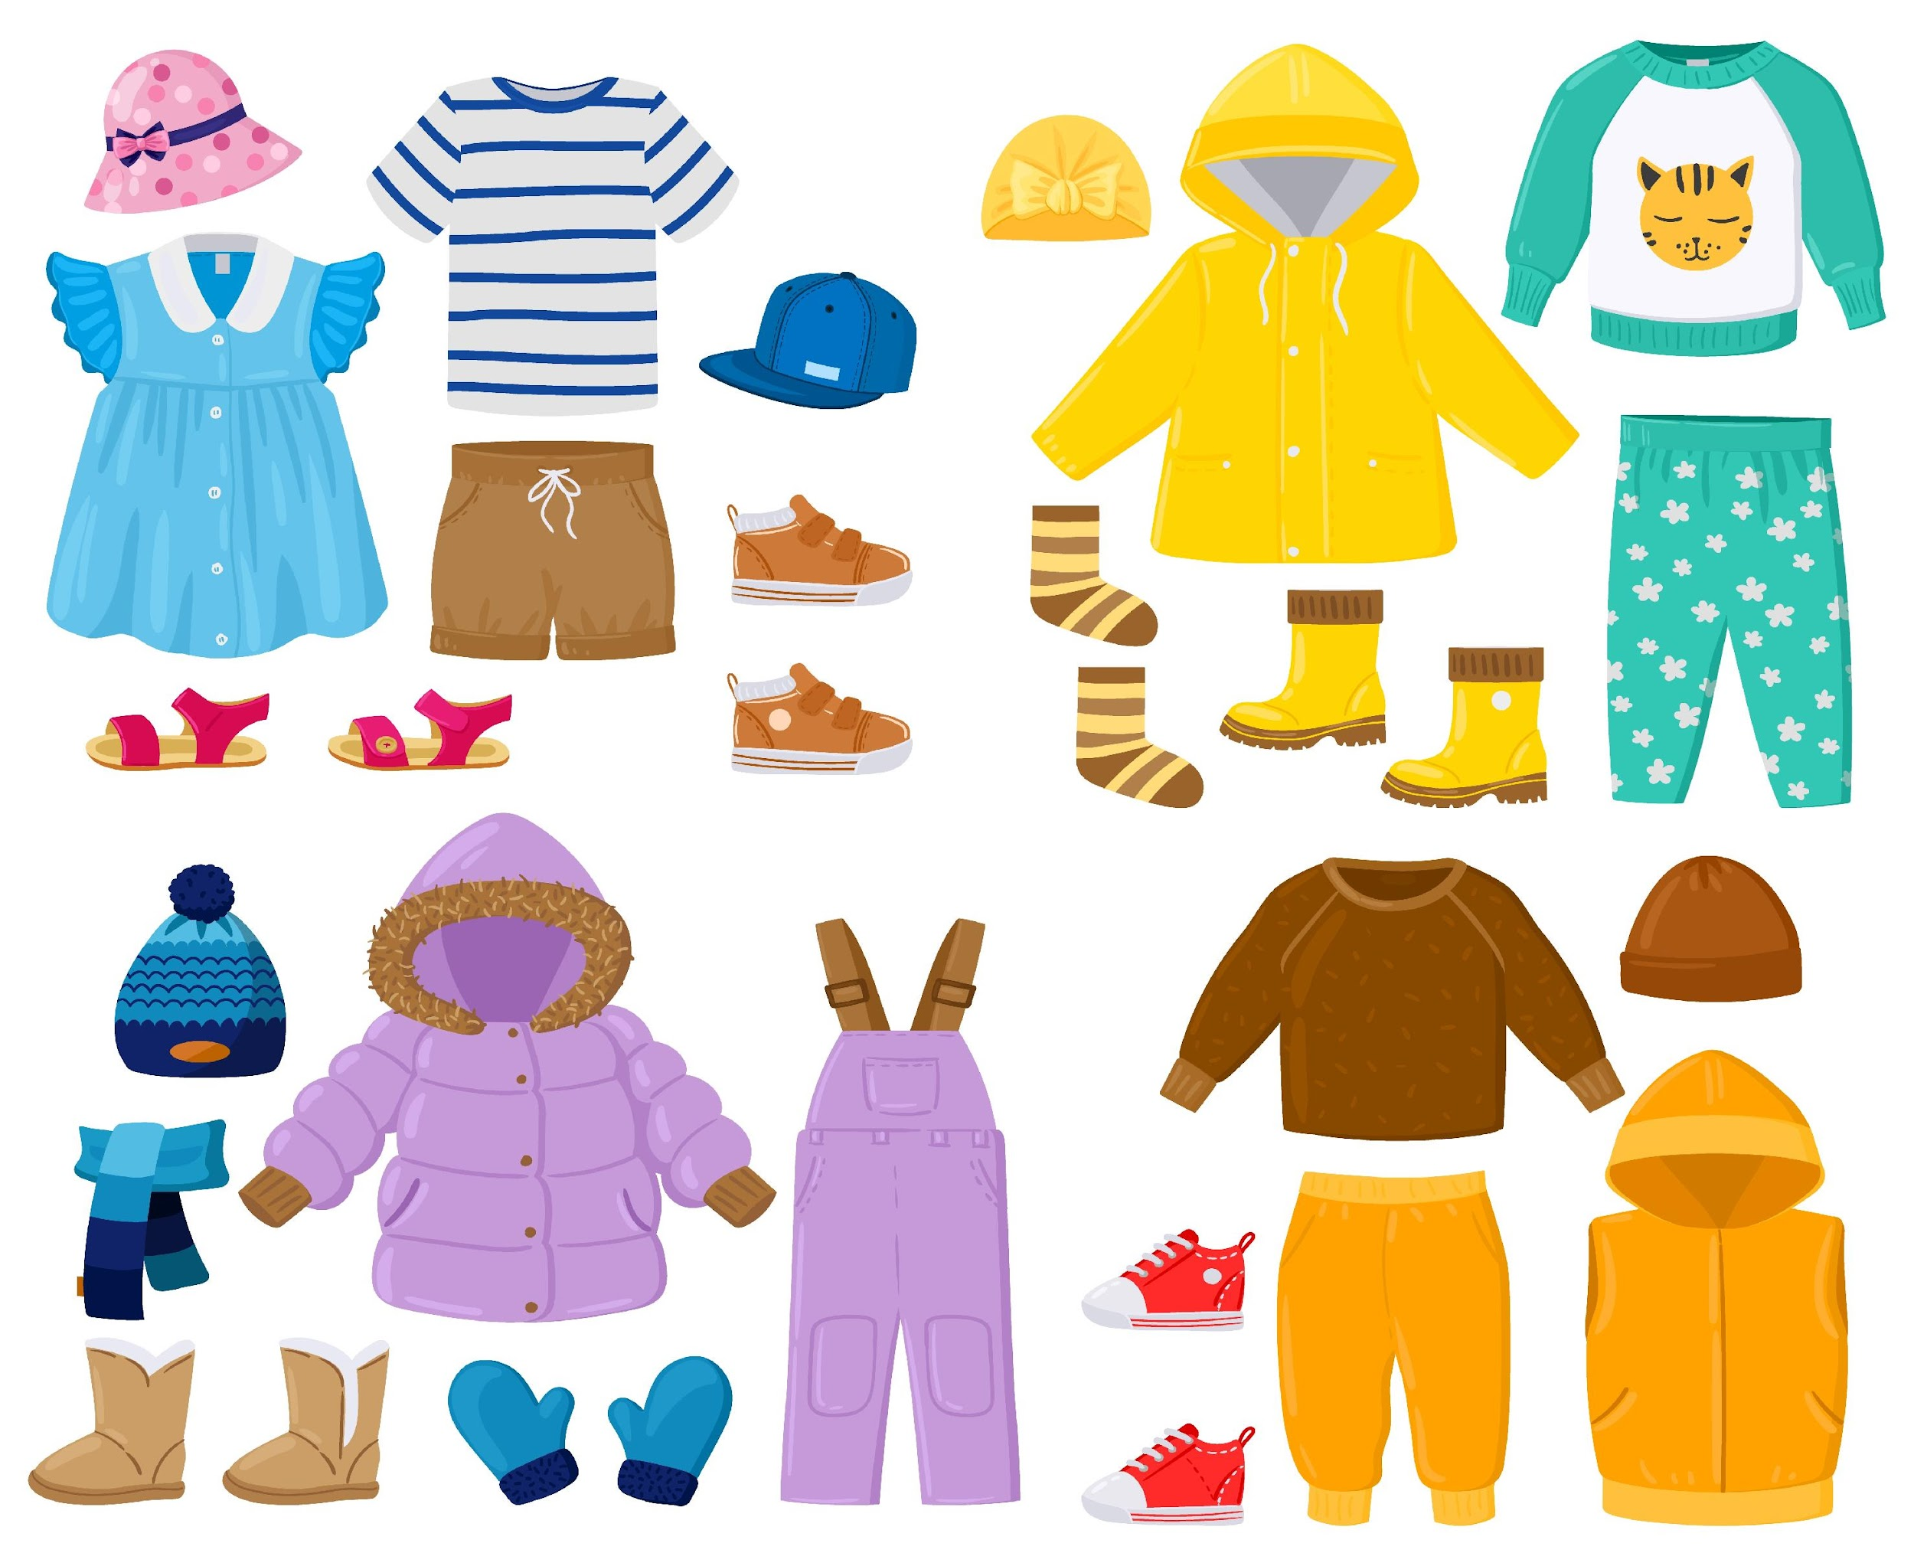
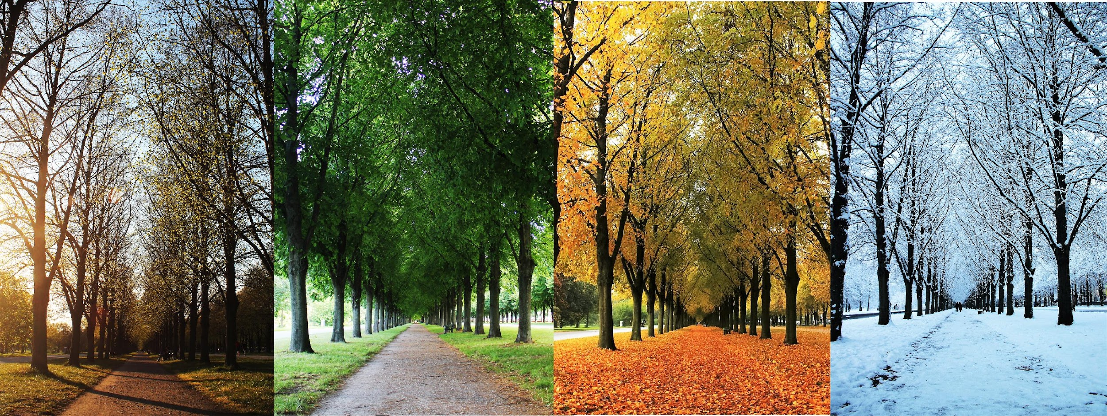
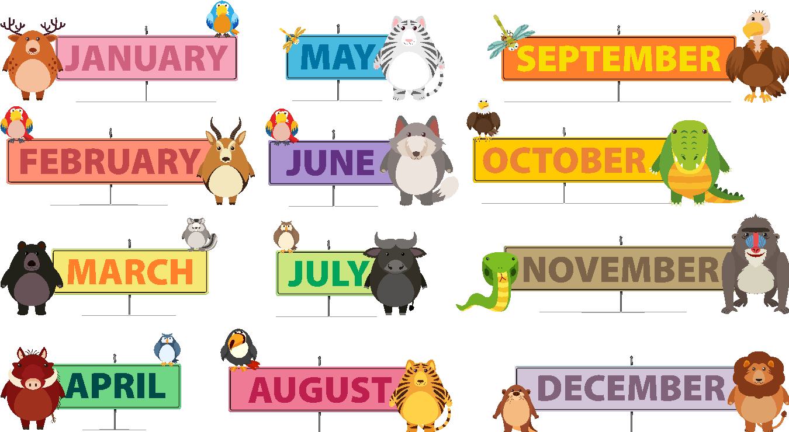
Knowledge Organiser: Seasonal Changes
Careers connected to materials:
meteorologist, weather forecaster, climatologist
Clothing to wear during each season
Months which fall into each season
Lesson Sequence
summer
spring
1. Understand there are four seasons
2. Understand the changes that take place in autumn
winter
autumn
3. Understand the changes that take place in winter
4. Understand the changes that take place in spring
Months of the year
5. Understand the changes that take place in summer
Seasons of the year
spring
summer
autumn
winter
6. Investigate how you can measure rainfall
Developing Experts Copyright 2022 All Rights Reserved

Slide 3


Unit Rocket Words: Year 1 – Seasonal Changes
Rocket Words
season | one of 4 parts of the year; spring, summer, autumn and winter
spring | a season between March and May
summer | a season between June and August
autumn | a season between September and November
winter | a season between December and February
hibernate | to sleep through the winter
temperature | how warm or cool something is
weather | the conditions and temperature outside
Developing Experts Copyright 2022 All Rights Reserved

Slide 4


