Slide 1
Year 5 Autumn Term 2025
Knowledge Organisers

Slide 2
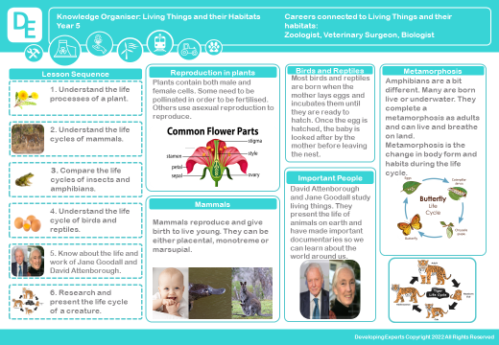

Slide 3
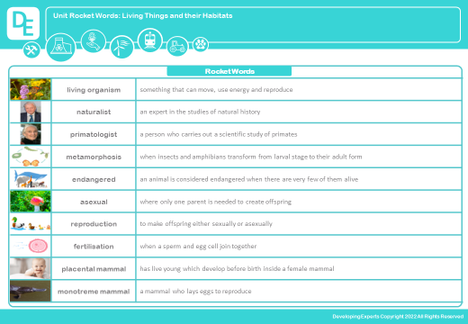

Slide 4
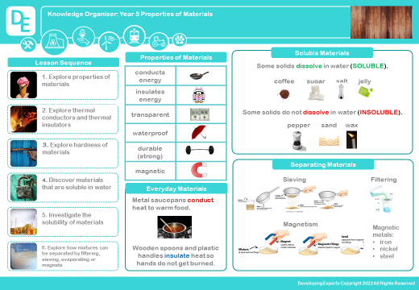

Slide 5
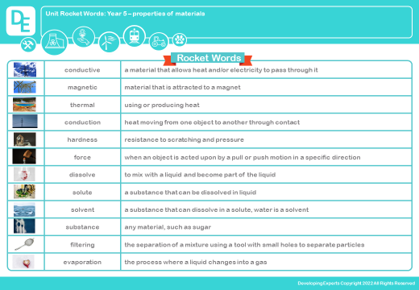

Slide 6


