Slide 1






A PARENTS GUIDE
  TO THE
EARLY YEARS FOUNDATION STAGE AT
Newbold Verdon Primary School

Slide 2


  INTRODUCTION
Welcome to the Early Years Foundation Stage (EYFS).
This is how the Government and early years’ practitioners describe the time in your child’s life between birth and age 5.
  Throughout the Pre School and Reception years your child will partake in an ambitious curriculum which is designed in a sequential way to ensure progress towards our end of year curricular goals.
At Newbold Verdon Primary School
our curriculum incorporates everything we want the children to experience, learn and be able to do. It meets all the requirements of the educational programmes in the statutory framework for the Early Years Foundation Stage (EYFS) and has the flexibility to allow us to respond quickly to children’s new interests and/or needs.
The intent for our children is for them to enter the next stage of their education ready to tackle new challenges with confidence and a positive mindset.

Slide 3


THE SEVEN AREAS
  OF LEARNING
Your child will be learning skills, acquiring new knowledge and
demonstrating their understanding through 7 interconnected areas of
learning and development.
  Children should mostly develop the 3 prime areas first. These are:
  COMMUNICATION AND LANGUAGE
  PERSONAL, SOCIAL AND EMOTIONAL DEVELOPMENT
  PHYSICAL DEVELOPMENT
These prime areas are those most essential for your child’s healthy development and future learning.
As children grow, the prime areas will help them to develop skills in 4 specific areas.
  These are:
  LITERACY
  MATHEMATICS
  UNDERSTANDING THE WORLD
  EXPRESSIVE ARTS AND DESIGN
These 7 areas are used to plan your child’s learning and activities. At Newbold Verdon Primary School our experienced EYFS teaching team ensure that tasks and challenges are suited to your child’s unique needs and interests.
  Children in the EYFS learn by playing and exploring, being active, and through creative and critical thinking. Our environment indoors and outdoors is continually enhanced with resources designed to scaffold and maximise learning.

Slide 4


"WHEN WE GIVE
EVERY CHILD
THE BEST START
IN THEIR EARLY YEARS, WE GIVE THEM WHAT THEY NEED TODAY.
WE ALSO SET THEM UP WITH EVERY CHANCE OF SUCCESS TOMORROW”
DEVELOPMENT MATTERS 2021
  Newbold Verdon Primary School

Slide 5


  OUR SCHOOL VALUES
Our values make us who we are and help us to stay focused on what we do and how we do it. After consulting our community, we decided that our values:
Aspirational (aim high)
Uniqueness(celebrate differences)
Curious(want to know more)
Perseverance(keep trying)
Courage(have a go)
Empathy(think of others)
encapsulate our vision for our children.
When the children enter the EYFS they quickly learn that experiences, challenges and new learning can be seen through the lens of being brave and resilient in the face of challenge, being kind and responsible people and being curious, creative knowledgeable and imaginative.

Slide 6


  HOW CAN I HELP AT HOME?
  Building positive relationships with the families of Newbold Verdon Primary School, creating a ‘triangle of trust’ between children, parents and practitioners begins in the Early Years. We understand that when parents relinquish part of the care and teaching of their child to the staff in our setting it is a big step. We pride ourselves on creating an environment that is warm and welcoming. Each day leads to a deeper knowledge and understanding of each child and their family.
  All the fun activities that you do with your child at home are important in supporting their learning and development and have a long- lasting effect on your child’s learning as they progress through school. You are your child’s first educators, and we greatly value any input, opinions and information you can share with us about your child. Working together as partners will set the scene for your child to thrive at Newbold Verdon Primary School
  Make time for your child to run, jump, climb and PLAY OUTDOORS!
  Share a book.
  Play board games that involve moving a certain number of steps on and play with dice and dominoes.
  Cook / bake together.
  Allow your child to see you reading for pleasure or writing for a purpose such as making shopping lists or writing birthday cards.
  Sing and tell nursery rhymes.
  Plant seeds or bulbs in a pot or garden patch.
  Play games that encourage sharing and taking turns.
  Talk to your child at every opportunity – e.g., what you are doing that day.

Slide 7
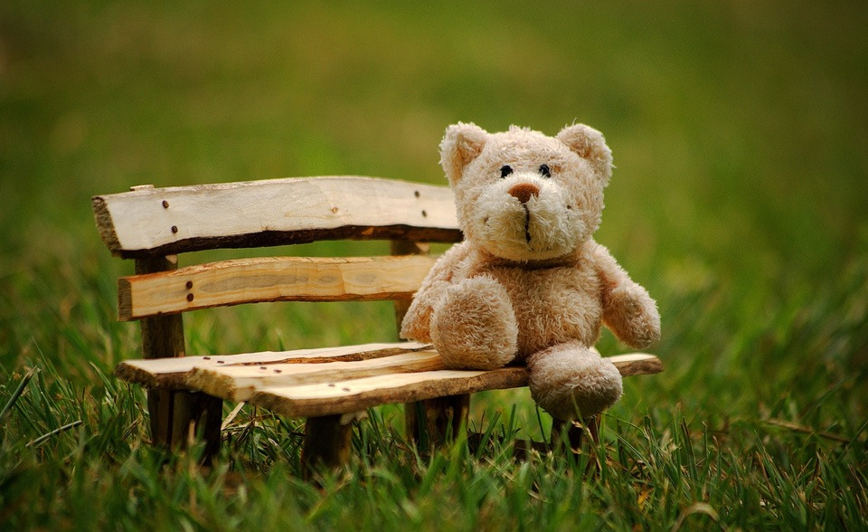

  HOW CAN I FIND OUT HOW MY CHILD IS GETTING ON?
  Throughout the year we have different opportunities to see your child's classroom environment and work they would like to share. We also have half termly ‘Book and a Biscuit’ sessions where you can share a book with your child in the classroom
  When your child is 5 (At the end of the EYFS) – in the summer term of the reception year in school, teachers complete an assessment which is known as the EYFS Profile. This assessment is carried out by the reception teacher and is based on what they, and other staff caring for your child, have observed over a period of time. A written report will come home towards the end of the Summer term and opportunities are given for you to come in and discuss this with the class teacher.
  We provide many opportunities for parents and carers to take an active part in their child’s education and find out how your child is getting on. These include:
  Access to Tapestry. This provides parents/carers with real time access to observations teachers have taken in class.
  Parent meetings - in the Autumn and Spring term, you will be invited to discuss your child’s progress. A summary of their development will be discussed with you and how you can support their learning at home.

Slide 8


THANK YOU FOR CHOOSING
  Newbold Verdon Primary School
  Please look at our website for more detailed information about the EYFS curriculum.

